Slide 1
Client Side
I 14

Slide 2
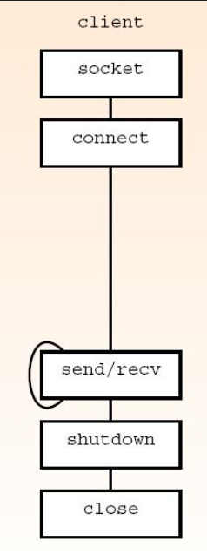
ALGORITHM
FLOW-CHART
STEP 1:START
STEP 2:SOCKET CONNECTION
STEP 3:CONNECT THE SOCKET
STEP 4:SEND & RECEIVE MESSAGES
STEP 5:SHUTDOWN THE SOCKET
STEP 6:STOP

Slide 3
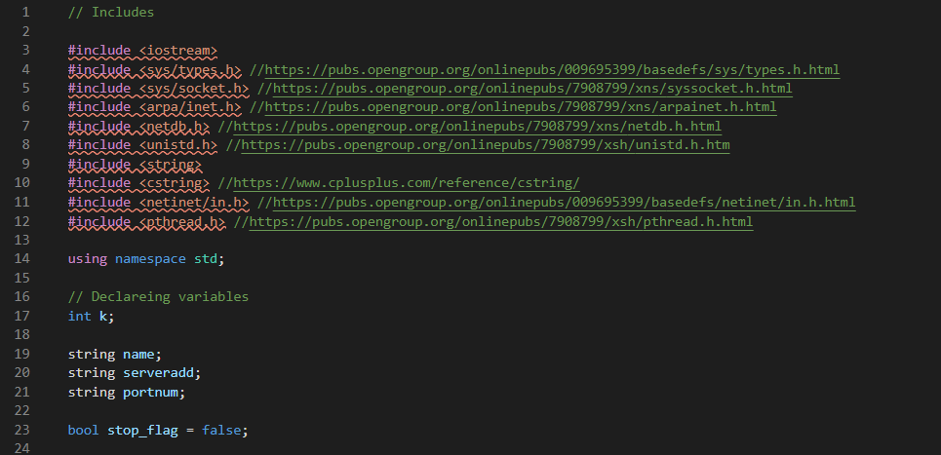
CODE INSIGHTS

Slide 4
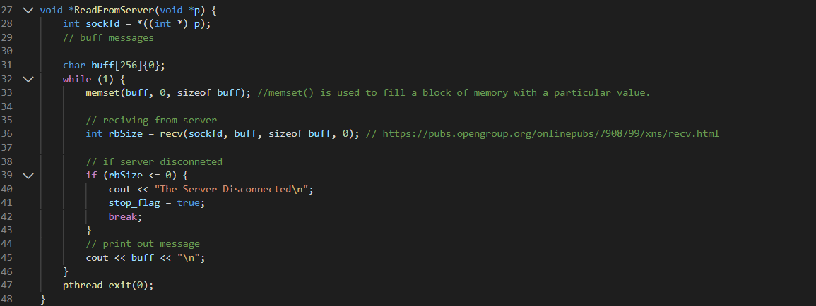
TO READ FROM SERVER

Slide 5
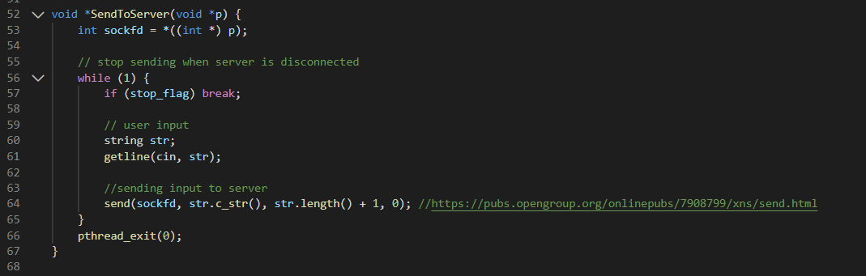
TO SEND TO SERVER

Slide 6
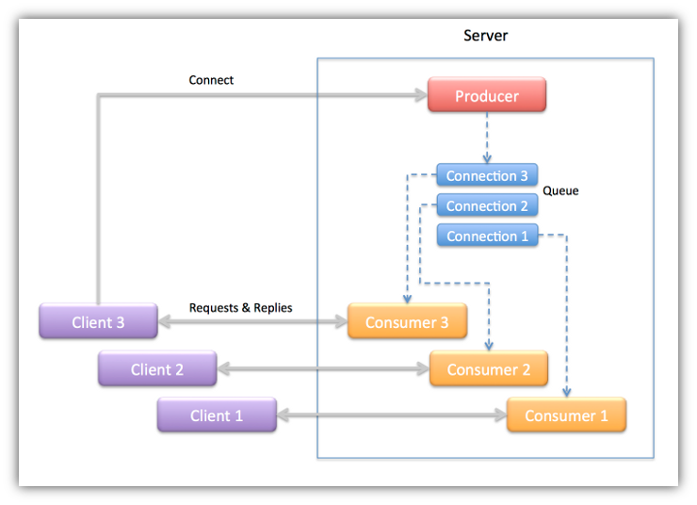
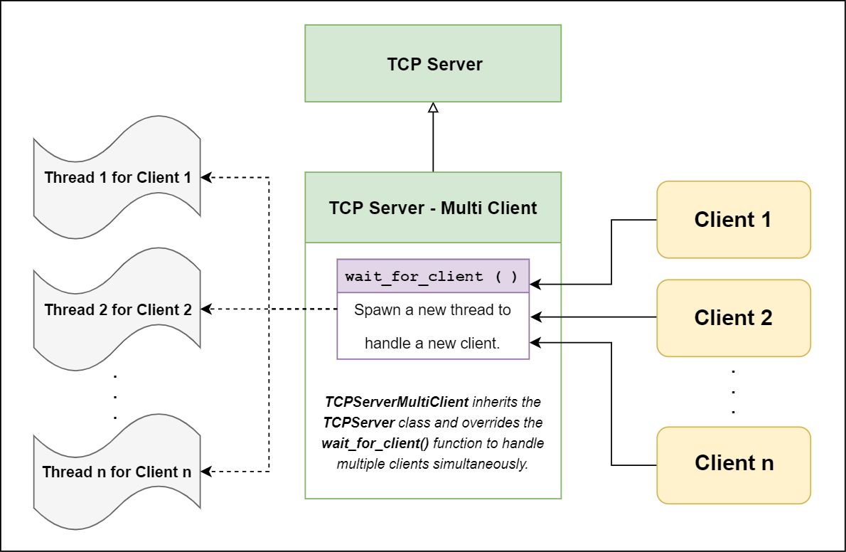
THREADING
A thread of execution is a sequence of instructions that can be executed concurrently with other such sequences in multithreading environments, while sharing a same address space. An initialized thread object represents an active thread of execution; Such a thread object is joinable and has a unique thread id.
To start a thread, we simply need to create a new thread object and pass the executing code to be called (i.e, a callable object) into the constructor of the object. Once the object is created a new thread is launched which will execute the code specified in callable. After defining callable, pass it to the constructor.

Slide 7
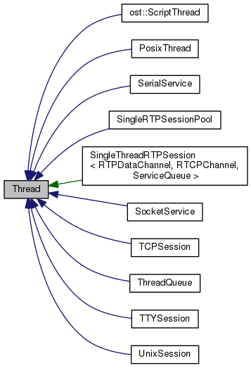
For Threading there are basically two needs Creating the Thread & Joining the Thread.As shown in the Program for Server.cpp we use #include <pthread.h> header file and for clientwin.cpp we use #include <thread>
The pthread_create() function is used to create a new thread, with attributes specified by attr, within a process. If attr is NULL, the default attributes are used. If the attributes specified by attr are modified later, the thread's attributes are not affected. Upon successful completion, pthread_create() stores the ID of the created thread in the location referenced by thread.
SERVER CLIENT
// CREATING THREADS // CREATING THREADS
pthread_t tids_recv[BACKLOG];
pthread_attr_t attrs_recv[BACKLOG];
string clientNames[BACKLOG];
for (int i = 0; i < BACKLOG; ++i) {
pthread_attr_init(&attrs_recv[i]);
thread thread1(ReadFromServer, &sockfd);
thread thread2(SendToServer, &sockfd);
// JOINING THREADS
thread1.join();
thread2.join();
// JOINING THREADS
for (int i = 0; i < k; ++i) {
pthread_join(tids_recv[i], NULL);

